Slide 1
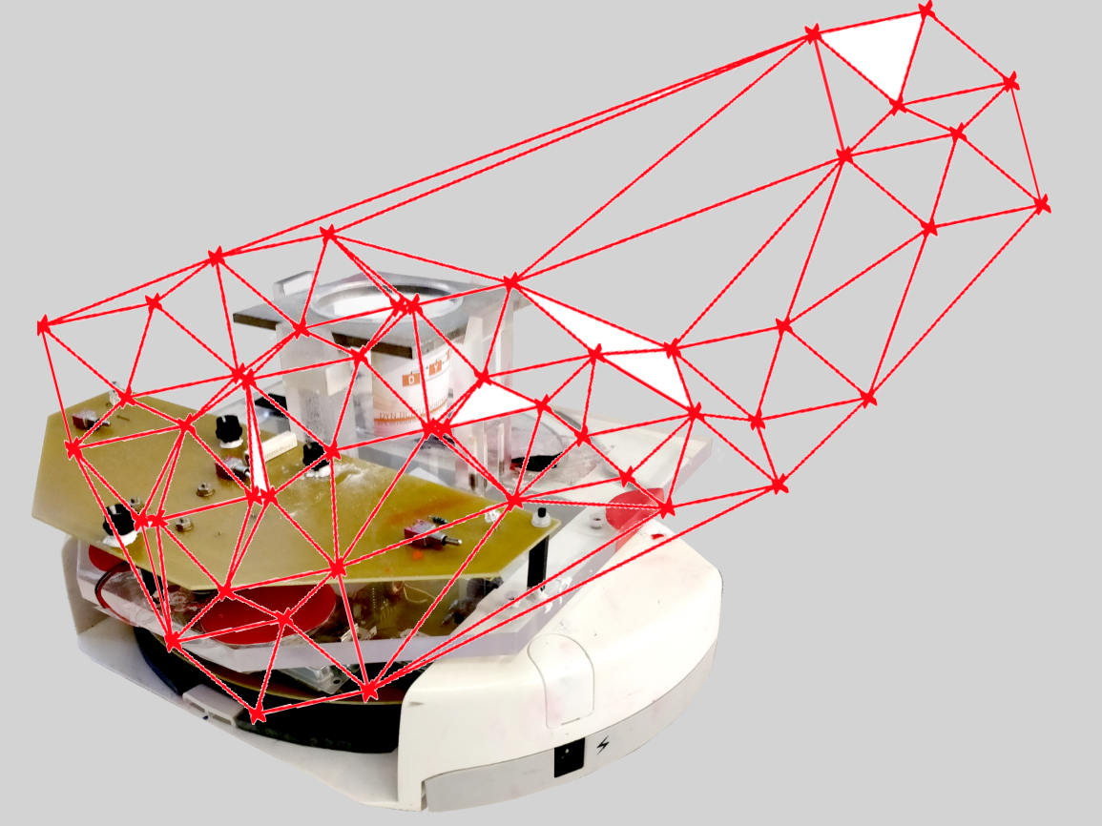
Project group SS18
Development of local positioning system for a pipe-less plant

Slide 2
Task for last Week
Logging Positions in Arslan code
Update the Emulator
Send data from the microcontroller to the PC (WiFi)
New WiFi module

Slide 3
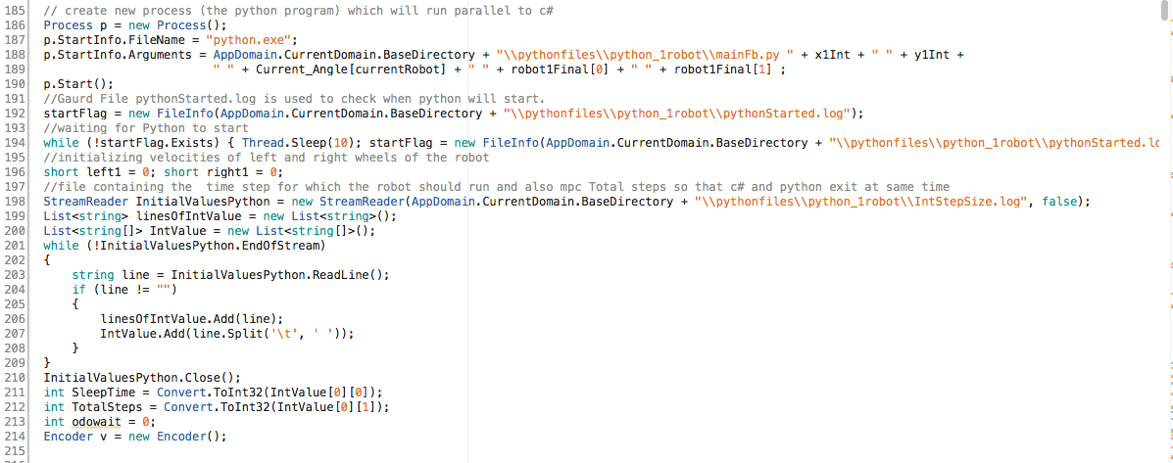
Python running parallel to C#

Slide 4
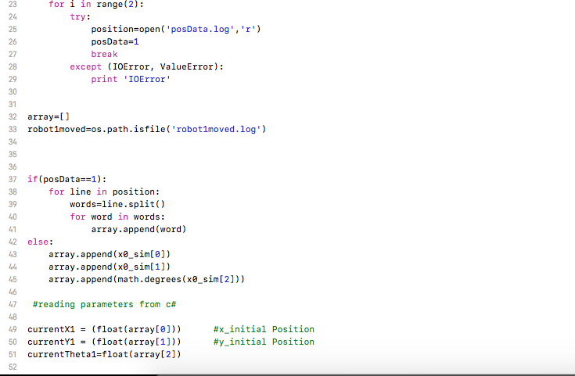
Positions to python and in python

Slide 5
Comparison
Modules | Old Arslan Code | New Arslan Code
Position Logging | no | yes
Connecting to Robot | yes | no
Calibration | yes | yes

Slide 6
Updates
New ARSLAN Code
Position Logging possible.
Replaced the connection “GATEWAY” code with the working module.- Still Failed Connecting.
Old Arslan Code
Same NMPC Code.

Slide 7
Tasks
RFID
Data rate for multiple tags
Emulator (Starting Proc)
Solver Starting Position and Orientation

Slide 8
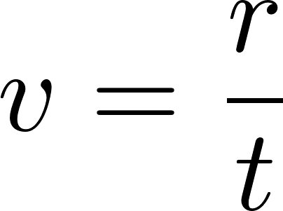

Detection of many tags
Realistic detectiontime t = 0.03 s, radius of r = 0.10 m
(binary tree)
+ additional computation time
# of tags = n | t(n) [s] | V [m/s]
1 | 0.03 | 3.33
2 | 0.09 | 1.11
3 | 0.15 | 0.67
4 | 0.21 | 0.48

Slide 9
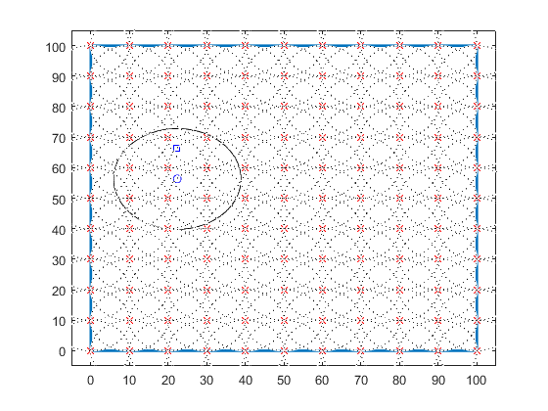
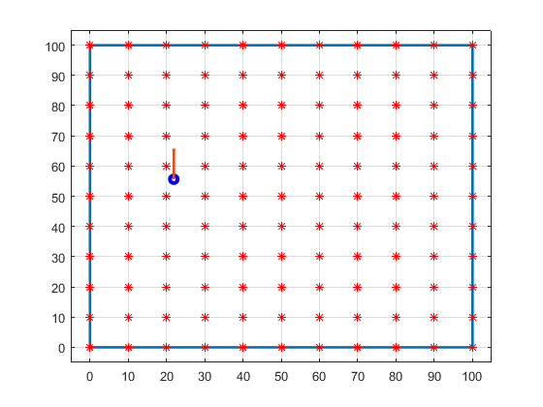
Emulator 3 + Solver
Starting at 22.4, 56.3 Starting at 21.9, 55.65
Orientation 90.4° Orientation 89.8°

Slide 10
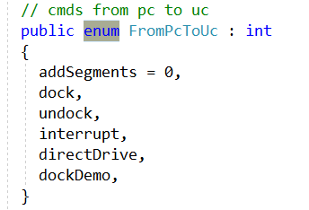
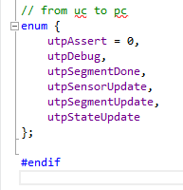
Information Transfer Protocol
From PC to Microcontroller
From Microcontroller to PC

Slide 11
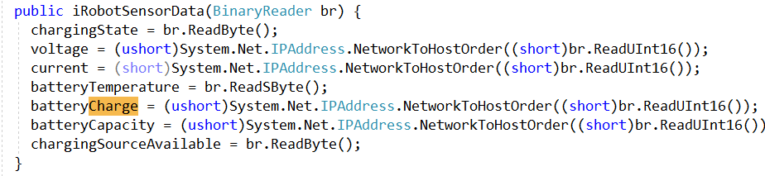
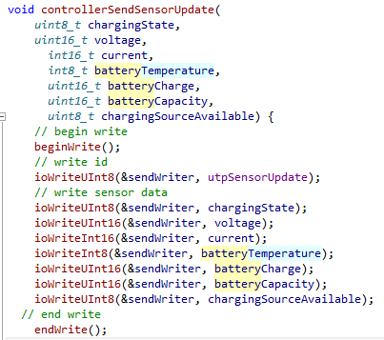
Sensor Data
VISUAL STUDIO
AMEGA

Slide 12
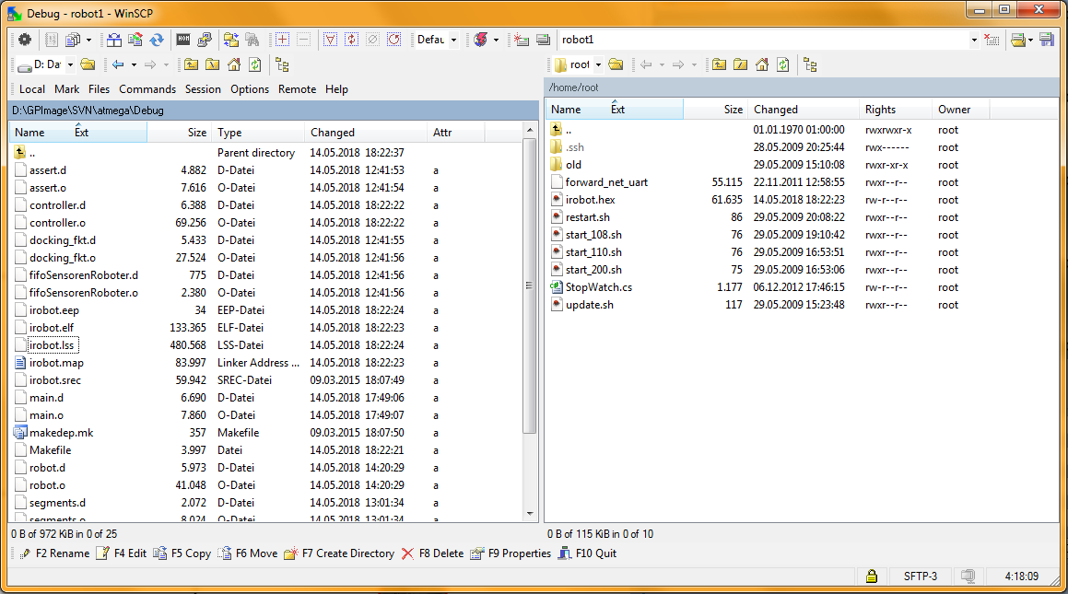
Updating the code via. WinSPC

Slide 13
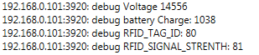
Updating the code via. WinSPC

Slide 14
Alternative Scenario
UARTs are all used in the current microcontroller
Use I2C pins if applicable
n
+ Use 1 IP address for each robot
- Edit the robot code (High effort)
Communicate with the new uC
Send data over WiFi (Done Steffan)
- Edit the receiving module code on the PC
Old uC
New uC
Reader

Slide 15
Alternative Scenario
n
- Each robot 2 IP address (one robot/one reader)
+ No change for the robot code
+ create new Visual Studio code module:
receive readings from reader IP address
Localization Algorithm
Run Arslan Python Script with the new positions
PC
WiFi Module
Reader

Slide 16
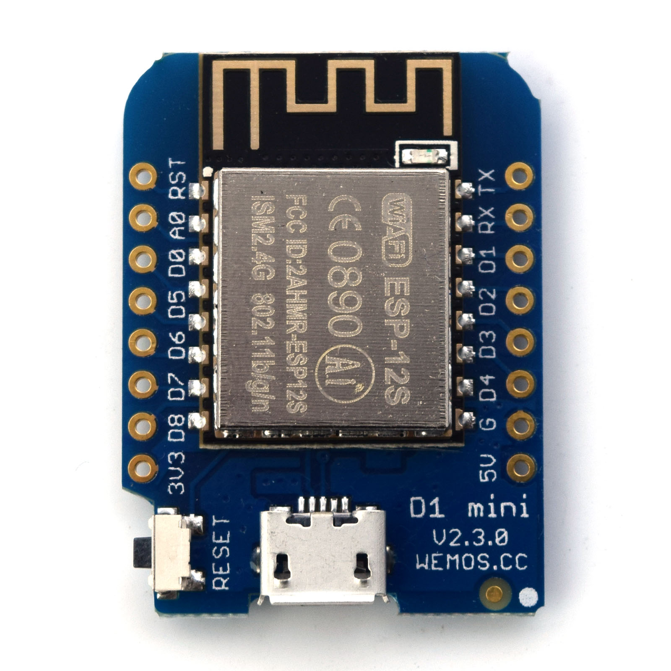
WeMos WiFi Module
Cost: 5 Euros each
Easy to Code
Using Arduino IDE
Connection Easy
Example Done
Marina Ordered it

Slide 17
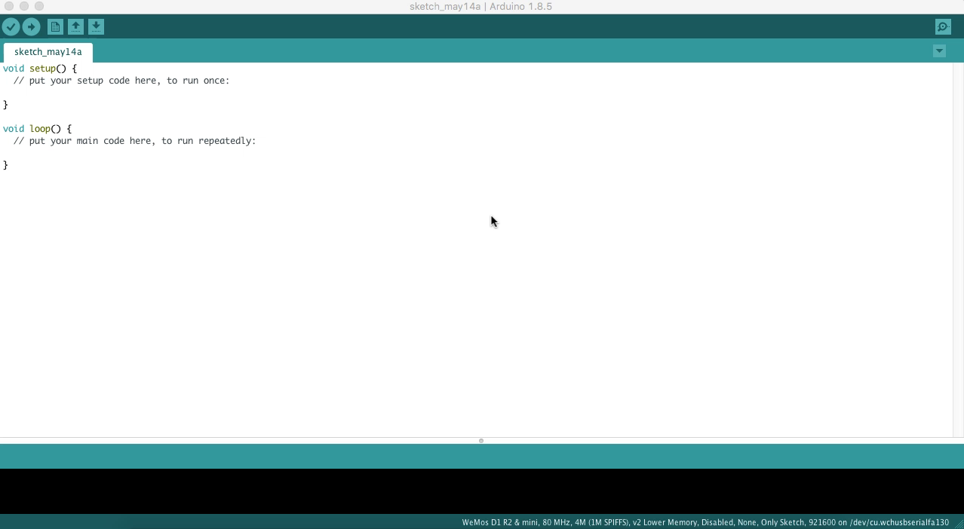
Sending Data over WiFi

